Slide 1
RISC-V Debug
Sajjad Ahmed

Slide 2
Topics included
Debug system overview.
Debug module features.
Hart states.
Abstract commands.
Debug registers.
Entry and exit sequence of debug mode.
Break point insertion flow.
Translation of abstract commands.

Slide 3
Topics not included
Commands for program buffer execution.
Command for system bus access.
Details of memory write operations through jtag.
Details of quick access command.

Slide 4
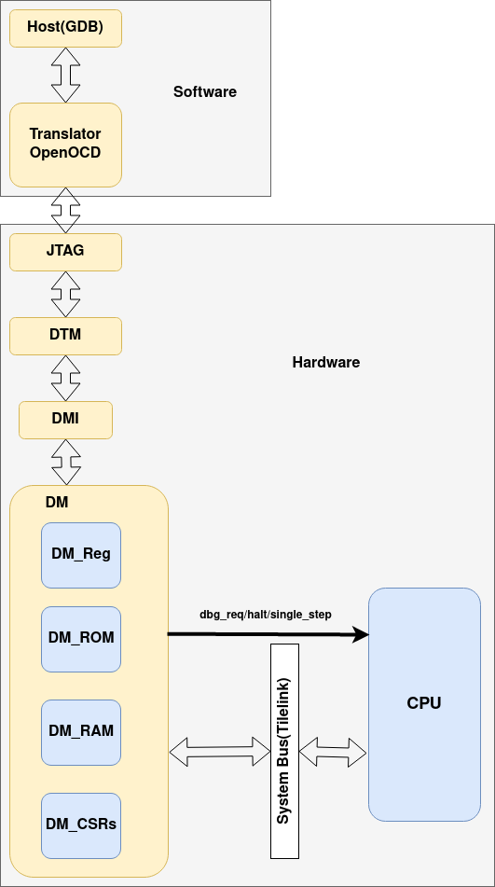
System overview

Slide 5
Debug Module Features
Give necessary information about hart implementation to debugger.
Halt and resume any hart.
Provides abstract read write commands on halted hart.
Controls reset signal to debug hart from very 1st instruction.
Provide program buffer for executing arbitrary instructions.
Provide system bus access.
Debug upto 2^20 harts.

Slide 6
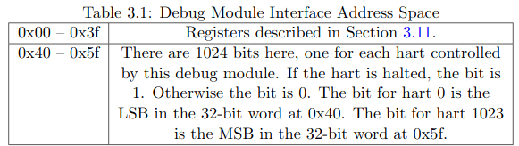
DMI
DMI is debug bus master.
Supports read write operations.
It uses 7 to 32 bits for addressing.
If multiple debug modules are present then address of next DM is given by nextdm register.

Slide 7
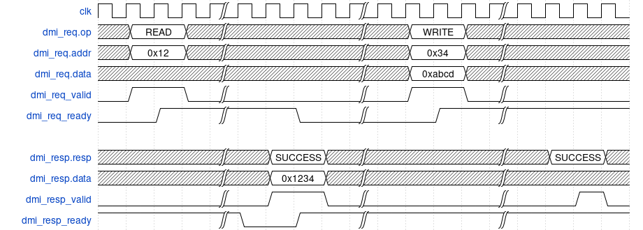
DMI timing diagram.

Slide 8
Reset control
Reset all harts.
Reset selected harts.
DM and DTM can be reset on power-up and when dmactive in dmcontrol is 0.
Controls a global reset (ndmreset).
Abstract commands can be executed during reset state.
Only supported operation during ndmreset or any system reset is accessing dmcontrol.

Slide 9
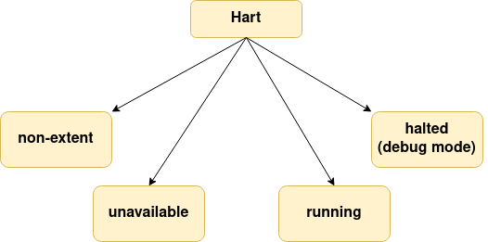
Hart states

Slide 10
Run control
DM keeps tracks of 4 conceptual bits for every hart. (1) halt req (2) resume ack (3) halt on reset (4) hart reset. All bits reset to 0 except resume ack.
DM receives halted, running and havereset signals from hart.
State of resume ack is tracked in allresumeack, anyresumeack. State of halted is tracked in allhalted and anyhalted. State of running is tracked in allrunning and any running. And state of reset is tracked in allhavereset and anyhavereset bits of dmcontrol.

Slide 11
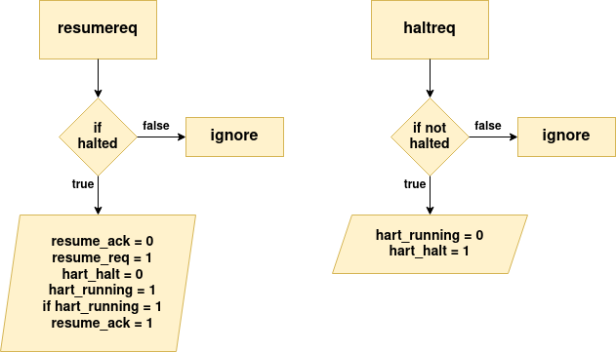

Slide 12
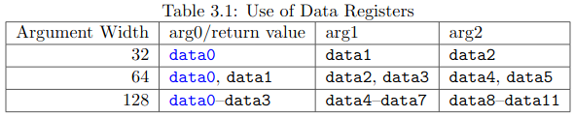
Abstract commands
Debugger can execute abstract commands by writing them to command.
Status of command can be seen in busy bit of abstractcs.
Completion of command can be observed in cmderr bits of abstractcs if 0 then execution was successful.
If command takes arguments then debugger must write them into data regs of DM before writing into command. And if command returns values then DM must write them to data regs before clearing the busy bit in abstractcs.

Slide 13
Abstract commands cont.
Before starting abstract command debugger must ensure that haltreq, resumereq and ackhavereset are 0.
During execution of abstract command busy bit of abstractcs must be set. And hartsel must be retained. Debugger must not write 1 to haltreq, resumereq and ackhavereset.
If the command is hung during execution then debugger must reset the hart using hartreset and ndmreset. And then reset the DM using dmactive.
If the hart is unavailable and command starts execution or hart becomes unavailable during execution then debugger simple terminate the process by clearing the busy bit low and cmderr to 4.

Slide 14

Abstract command listing
Three types of abstract commands are supported on RISC-V DM.

Slide 15
Access Register Command
Provide access to cpu registers and execute program buffer. It has following sequence of execution.
1. If write is clear and transfer is set, then copy data from the register specified by regno into the arg0 region of data.
2. If write is and transfer are set, then copy data from the arg0 region of data into the register specified by regno..
3. If aarpostincrement is set, increment regno.
4. Execute the Program Buffer, if postexec is set.
Incase of any error cmderr is set and no further instruction will execute. If error is due to non-existent register in hart then cmderr must be set to 3(exception).

Slide 16
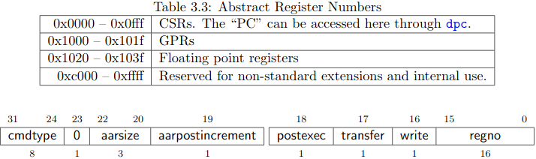
Access Register Command cont.

Slide 17
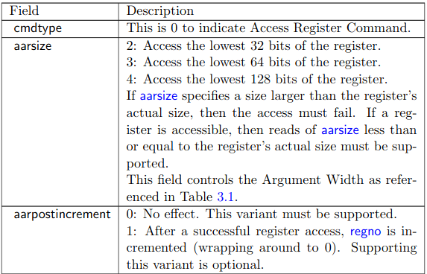
Access Register Command fields

Slide 18
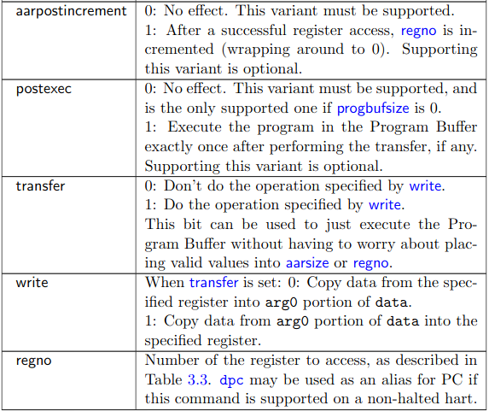

Slide 19
Quick Access Command
Quick access command has following sequence of execution.
If the hart is halted, the command sets cmderr to “halt/resume” and does not continue
Halt the hart. If the hart halts for some other reason (e.g. breakpoint), the command sets cmderr to “halt/resume” and does not continue.
Execute the Program Buffer. If an exception occurs,cmderr is set to “exception” and the program buffer execution ends, but the quick access command continues.
Resume the hart.

Slide 20
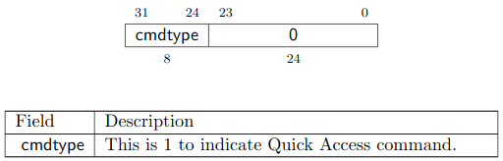
Quick Access Command Fields

Slide 21
Access Memory
Memory access command has following execution pattern based on value of write field.
When write=0, copy data from the address specified by arg1 to the data register specified by arg0.
When write=1, copy data from the data register specified by arg0 to the address specified by arg1.
When aampostincrement=1, increase the value of the data register corresponding to arg1.

Slide 22
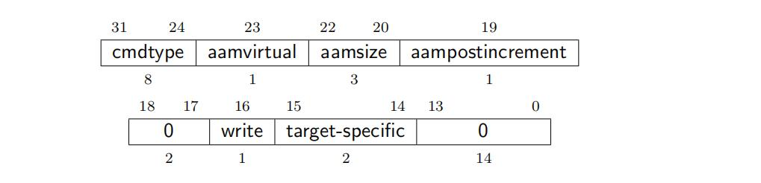
Access Memory command fields.

Slide 23
Access Memory command fields Cont.
cmdtype: The value is 2.
aamvirtual: 0 indicates that the physical address is accessed, and 1 indicates that the virtual address is accessed.
aamsize: 0 means access to the lower 8 bits of the memory, 1 means to access the lower 16 bits of the memory, 2 means to access the lower 32 bits of the memory, 3 means to access the lower 64 bits of the memory, 4 means to access the lower 128 bits of the memory.
aampostincrement: 1 means that after the access is successful, the value of the data register corresponding to arg1 is added to the number of bytes corresponding to aamsize.
write: 0 means copy data from the address specified by arg1 to the data register specified by arg0, 1 means copy data from the data register specified by arg0 to the address specified by arg1.
target-specific: reserved.

Slide 24
Program Buffer
Risc-v debug spec optionally defines the program buffer for executing small programs.
It can be of only one word or half word. In that case dmstatus.impebreak must be 1.
Program buffer can be executed by using access register command by setting postexec 1 in comand.
Pc value can be read using dpc during programm buffer execution.
It can be a RAM so, debugger can write small programs into it or it can be ROM for predefined set of instructions.

Slide 25
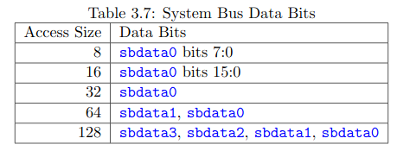
System Bus Access
System bus access is defined for accessing devices and memories without involving the cpu.
It improves debugging or memory accessing operations without setting the cpu in debug mode.

Slide 26
Debug Module Registers
Debug module registers are accessed over DMI bus.
Checking the implementation of register is only done by reading it if returns 0 then it is not implemented.
Each register is defined as 32 bit wide.

Slide 27

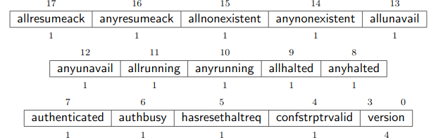
Dmstatus
This register holds the status of over all debug module. This is read only register.

Slide 28
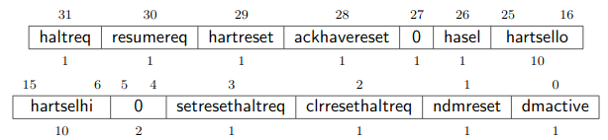
Dmcontrol
This register controls the entire debug module. It is read/write register.

Slide 29

Abstractcs
Abstract command status register. This register holds the status of abstract commands.

Slide 30
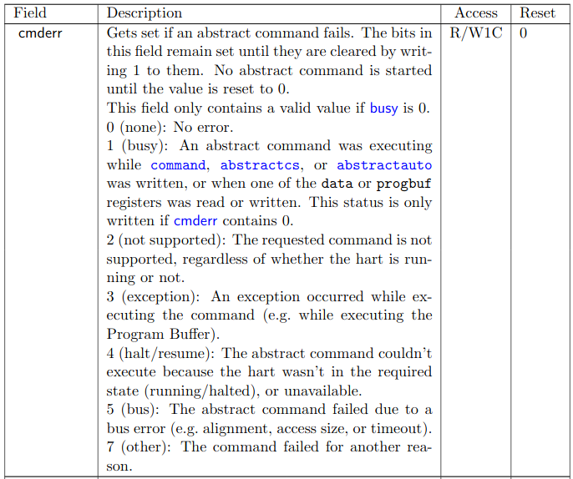

Slide 31
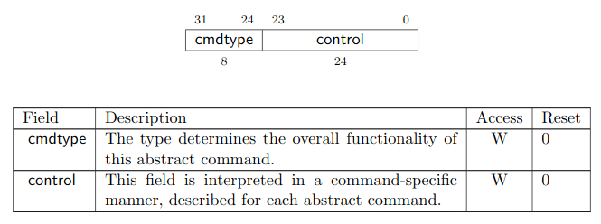
Command
This register holds the actual command for executing when hart is in debug mode.
This is write only register.

Slide 32

Hart info
This register gives info about currently selected hart. The whole register is read only.

Slide 33
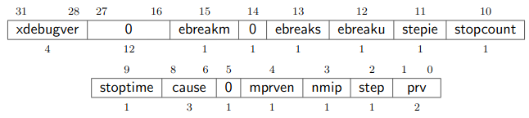
Debug control status register

Slide 34
Debug pc
This register holds the value of program counter upon entering debug mode.
It is read write register. When returning from debug mode pc is updated with the value of dpc.
Debugger can write the address from where it needs to start the program execution.

Slide 35
Debug Memory Map
Address | Description
0x0 to 0x0ff | unused
0x100 | Halted. Write to this address to acknowledge that the core is halted.
0x104 | Going. Write to this address to acknowledge that the core is executing.
0x108 | Resuming. Write to this address to acknowledge that the core is resuming non-debug operation.
0x10c | Exception. An exception was triggered while the core was in debug mode.
0x300 | WhereTo
0x338 to 0x35f | AbstractCmd
0x360 to 0x37f | Program Buffer (8 words)

Slide 36
0x380 to 0x388 | DataAddr
0x400 to 0x7ff | Flags
0x800 to 0x1000 | Debug ROM
0x800 | HaltAddress. Entry point into the Debug Module. The core must jump to this address when it was requested to halt.
0x804 | ResumeAddress. Entry point into the Debug Module. Jumping to this address instructs the debug module to bring the core out of debug mode and back into normal operation mode.
0x808 | ExceptionAddress. Entry point into the Debug Module. The core must jump to this address when it receives an exception while being in debug mode.

Slide 37
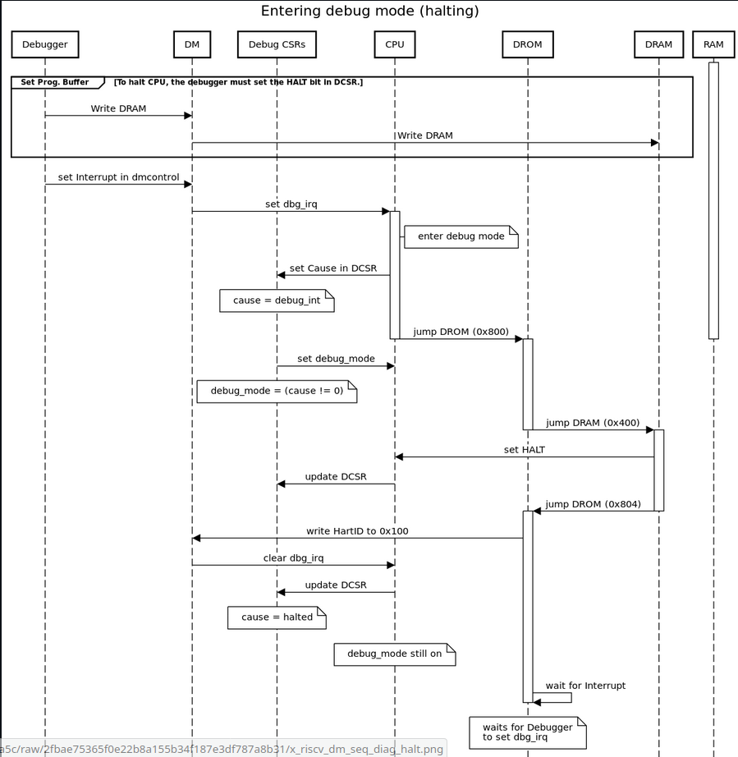

Slide 38
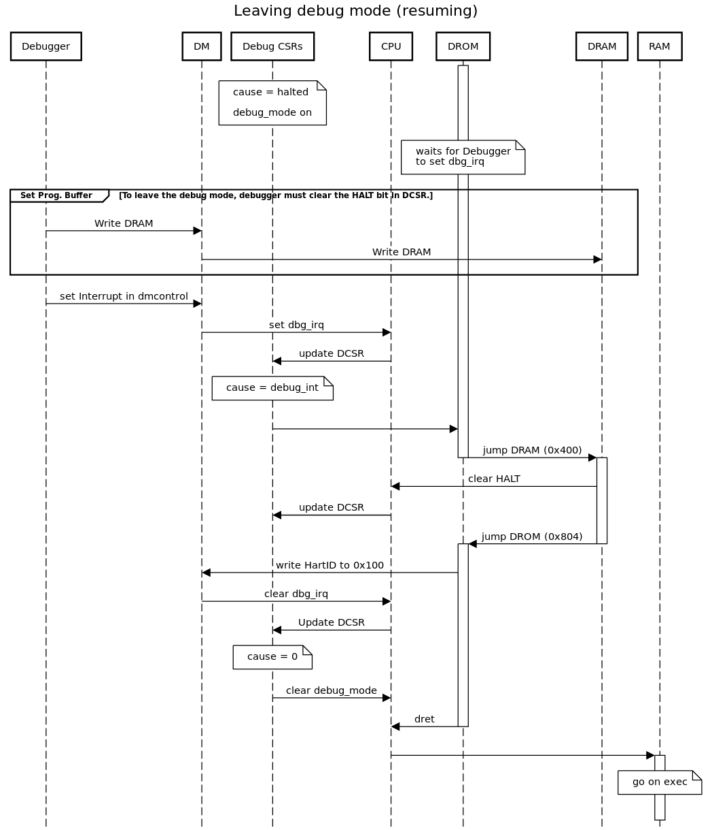

Slide 39
GDB to DM instruction flow
Any abstract command we use in gdb is written into command register. Fields of command registers are discussed earlier.
Break points:
Break func|N
This gdb command will write pc value into tmatch_value trigger register.
Then tmach_control trigger register will check when current pc == tmatch_value
It will raise tmach_o signal which sets core in debug mode. Hence control will transfer to DM.
So, we can say that break point is access register command.

Slide 40
Read/write register commands.
Info reg ra
This is an access register command which reads the value of ra(x1). For this instruction fields of command register will be as.
Command will be carried out in two steps.
writing command register.
Reading the value of data0 register for showing on terminal(this is done by translation of command register into sw instruction by dm_mem module. Sw instruction will write value of ra into data0).
0 | 0 | 2 | 0 | 0 | 1 | 0 | 0x1001

Slide 41
Info reg:
This command will print value of all the registers including PC(through DPC).
aarpostincrement = 1 indicates that the address of register will be updated every time after reading one register value successfully. This process will continue until reading the value of PC.
0 | 0 | 2 | 1 | 0 | 1 | 0 | 0x1000

Slide 42
Set $ra = 4
This is write register command.
This command will execute as following.
Write 4 to data0 register.
Write abstract command into command register.
Translate the command register into lw instruction(source address will be the address of data0 register).
0 | 0 | 2 | 0 | 0 | 1 | 1 | 0x1001

Slide 43
Set $ra += 4:
This command will add 4 into the current value of ra.
This command will execute in following manner.
Write 4 into data0 register.
Write command register.
Execute a lw instruction to shift the value 4 from data0 to a GPR.
Execute an add command to add the value of ra and GPR(which holds the value 4).
Execute sw instruction to store the result into data0 register.
Execute lw instruction to write the updated value into ra.
0 | 0 | 2 | 0 | 0 | 1 | 1 | 0x1001

Slide 44
References.
https://gist.github.com/brabect1/a39c5470b4cf49524919bfb3e3f20a5c
https://github.com/pulp-platform/riscv-dbg/blob/master/doc/debug-system.md
https://riscv.org/wp-content/uploads/2019/03/riscv-debug-release.pdf
https://www.programmersought.com/article/18815024316/

